Slide 1

Department of Computer Science And Engineering
Smart and Secure Attendance System Using RFID with Motion-Activated Readers, Automated Notifications
First Review
Batch No:06
Presented by
M Sivananthan - 410621104096
V Swetha - 410621104104
M Bhuvanesh - 410621104019
M Md Hasan Billal - 410621104063
Supervisor
Dr. M Sree Rajeswari
Assistant Professor

Slide 2
Abstract
Outline
Project title
Aim
Abstract
Existing System
Limitations of existing system
Proposed system
Block diagram of proposed system/Circuit Diagram
Advantages
Conclusion
References

Slide 3
Abstract
Aim
The aim of this project is to develop an RFID-based Smart Attendance System that automates attendance tracking in educational institutions and workplaces.
This system enhances accuracy, eliminates proxy attendance, reduces manual effort, and provides real-time data storage, making the process more efficient, secure, and reliable for both administrators and users.
This system integrates motion-activated RFID readers to ensure attendance is logged only when an individual is physically present, enhancing security and accuracy

Slide 4
Abstract
The Radio Frequency Identification (RFID) Smart Attendance System streamlines attendance tracking, enhancing accuracy, security, and efficiency in educational and business settings.
Each user receives an RFID card/tag, which, when scanned by an RFID reader, records attendance instantly and updates a secure database. This system minimizes manual errors, deters "buddy-punching," and provides administrators with immediate attendance reports.
Integration with IoT and cloud services enables remote monitoring and data analysis, further improving attendance management.

Slide 5
Existing Method
Manual Data Retrieval: Local database storage requires manual access, limiting efficiency and remote access.
Lack of Real-Time Monitoring: No live tracking or attendance updates for administrators.
High Power Consumption: RFID readers remain active continuously, leading to unnecessary energy usage.
Biometric Flaws: Sensors can fail due to tech issues or hygiene concerns.

Slide 6
Limitations of Existing Method
Error-Prone & Proxy Issues: Manual systems are easily manipulated and prone to mistakes.
Time-Consuming: Takes too long, especially in large group
No Real-Time Alerts: Absentees aren’t flagged instantly, making tracking hard.
Manual Record-Keeping: Requires extra effort for tracking and reports, adding to admin work.

Slide 7
Proposed System
Motion-Activated RFID Readers: Automatically logs attendance when motion triggers the RFID reader, ensuring accuracy and speed.
No Proxy Attendance: Records only when physically present, preventing fraud.
Real-Time Updates: Instantly stores data in a centralized database for easy access.
Automated Alerts: Sends SMS/email notifications to admins or parents about attendance status.
Less Admin Work: Automates attendance tracking, reducing manual effort and saving time.

Slide 8
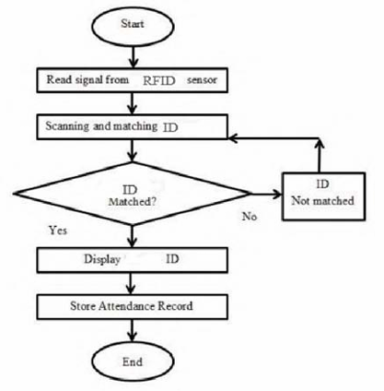
Fig 1 : Block Diagram of RFID
Block diagram of Proposed system

Slide 9
Advantages
Automation: Removes manual work, making attendance tracking faster and more efficient.
Enhanced Security: Stops proxy attendance and unauthorized access by requiring physical presence.
Real-Time Monitoring: Sends instant updates to admins or parents about attendance status.
Scalability: Works in schools, offices, and secure facilities.
Data Accuracy: Avoids human errors with precise, automated records.
Easy Report Generation: Creates attendance reports quickly for efficient management.

Slide 10
Conclusion
The Smart and Secure Attendance System provides an efficient, contactless, and automated solution for attendance tracking.
By integrating RFID with motion-activated readers and automated notifications, it enhances security, eliminates proxy attendance, and improves real-time monitoring.
This system ensures accuracy, reliability, and transparency, making it an ideal solution for schools, workplaces, and secure environments.

Slide 11
References
Base Paper Reference:
Lijuan Zheng; Chunlei Song; Ning Cao; Zhaoxuan Li; Wenfeng Zhou; Jianyou Chen.”A New Mutual Authentication Protocol in Mobile RFID for Smart Campus”,vol.6,IEEE, 14 October 2024
Reference Paper:
Keerthana Sanath, Meenakshi K, Muktha Rajan, Varshini Balamurugan, M.E.Harikumar.”RFID and Face Recognition based Smart Attendance System”, IEEE, 2021.
K. Aravindhan, S.K.B. Sangeetha, K. Periyakaruppan, K.P. Keerthana, V. Sanj ay Giridhar and V.Shamaladevi.”Design of Attendance Monitoring System Using RFID”, IEEE, 2021.
Inturi Meghana, J.D.N.V.L. Meghana and Ramesh Jayaraman.”Smart Attendance Management System using Radio Frequency Identification”, IEEE, 2020.
Qianwen Miao, Fu Xiao, Haiping Huang, Lijuan Sun and Ruchuan Wang. “Smart Attendance System Based on Frequency Distribution Algorithm with Passive RFID Tags”, vol.8, IEEE, 2020, pp.217-206.

Slide 12
THANK YOU

